Slide 1
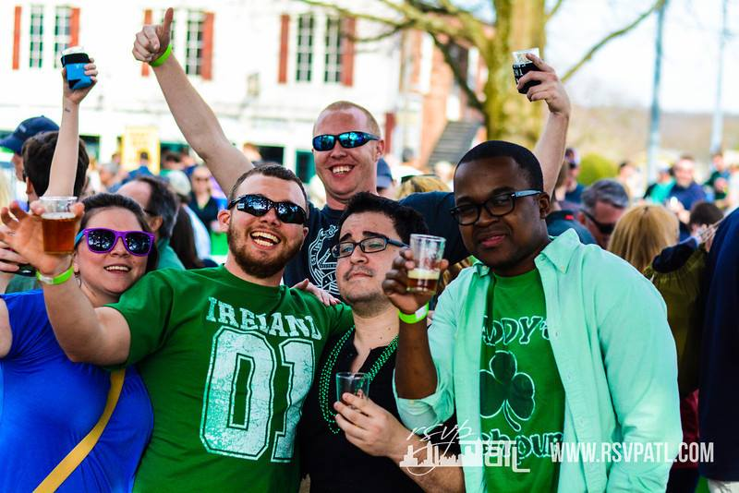
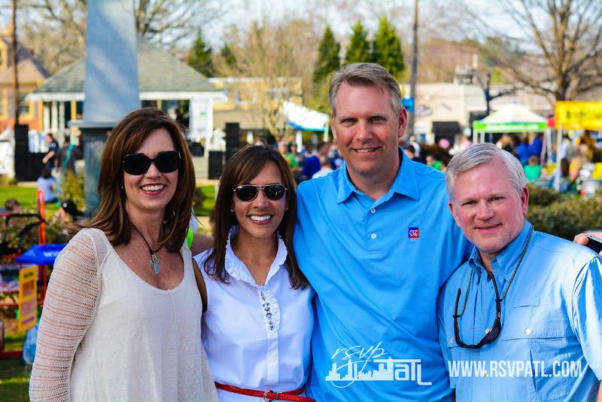
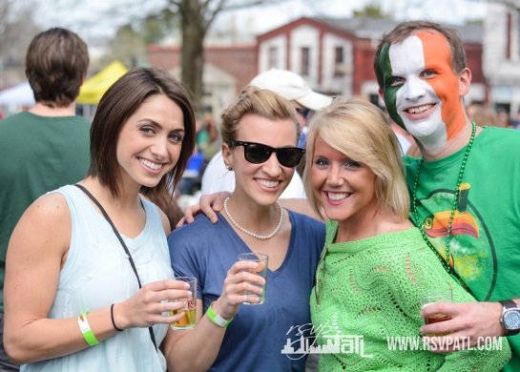
2017 Roswell Beer Festival
Sponsorship Opportunities
Sponsorships are tax deductible benefitting our 501(c)3
Saturday, March 25, 2017
Roswell Town Square
For Information Contact:
Stephanie Christiansen Stephanie.c@starhousefoundation.org
www.roswellbeerfestival.com
www.facebook.com/roswellbeerfest

Slide 2
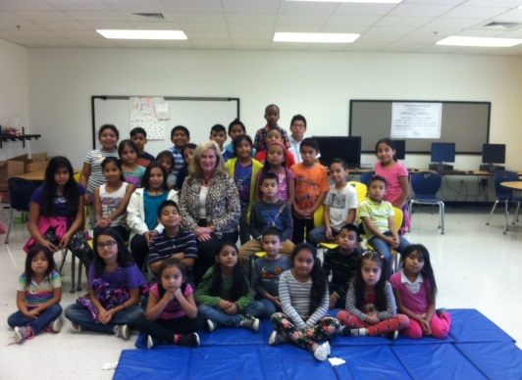
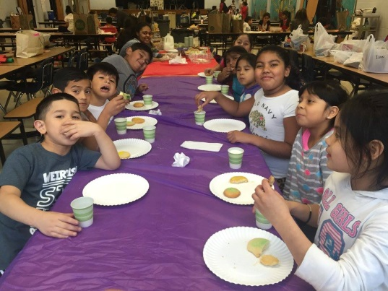
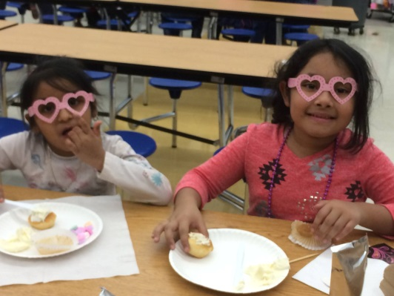
2017 Roswell Beer Festival
The Roswell Beer Festival is a one day event where participants can taste over 300 beers craft beers, many of them local, including some one-of-a-kind cask beers made just for our event.
Purpose: The purpose of this event is to raise awareness and funding to support the STAR House Foundation. STAR House is a non-profit 501(c)3 organization that provides after-school programs to at-risk children in North Fulton County, Georgia.
STAR House staff and volunteers provide on-site tutoring and mentoring while providing food and structured activities to our children. The children get help with, and are held accountable for finishing their homework, and they receive remedial instruction, are taught things like manners and good study habits. These children learn how to succeed in school, creating a foundation for success later in life.
100% of the net proceeds from this event go directly to the STAR House Foundation. Our goal is to net $100,000!
Where: Roswell Historic Town Square - at the intersection of Highway 9 and Highway 120 (easily accessible and a well- known, historic landmark.)
When: Saturday, March 25th 2PM-6PM (Some sponsor packages and VIP ticket-holders will have early access to the event.)
Attendee Demographics:
1,500 attendees, with an average age of 44
90% attendee satisfaction for previous year’s event
50% of attendees visit from outside of Roswell
Logistics: Roswell Town Square is a secure, partially wooded fenced-in area with a beautiful fountain, a gazebo/stage for music, and a side street that will be closed off for safety, fun, a plenty of room featuring some of Roswell’s best food vendors. Over 200 volunteers man over 100 booths, each offering craft beer samples to ticket holders in 5 oz souvenir glass. Food is available for sale via tokens and restrooms are provided. Now in its 5th year, the Roswell Beer Festival has become a must-attend event for people from all over the Atlanta metro.

Slide 3
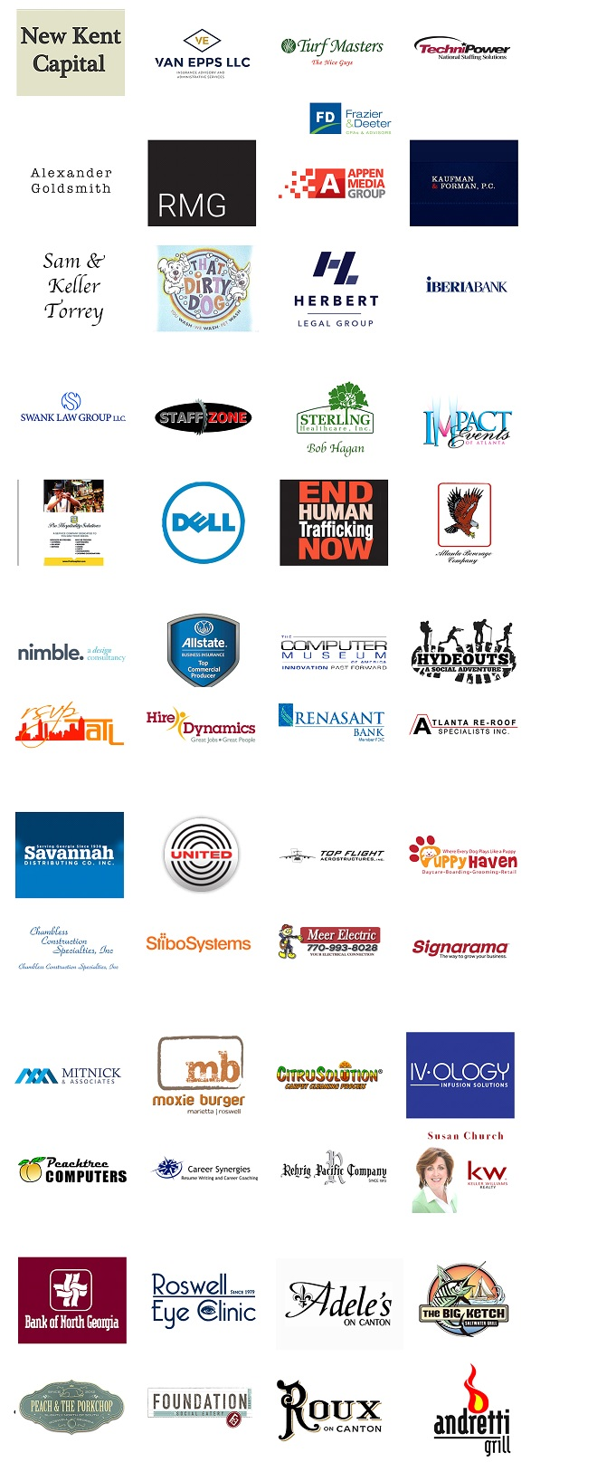
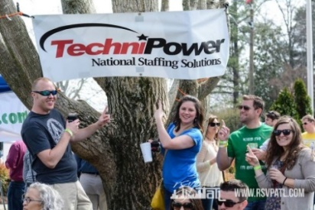
2017 Roswell Beer Festival
Sponsorship Levels
Brewmaster Sponsor $10,000*
Keg Sponsor $5,000
Food Token Sponsor $5,000*
Tap Sponsor $2,500
Water Sponsor $2,500 *
Music Sponsor $2,500
Pint Sponsor $1,000
Beer Tent Sponsor $500
2016 Sponsors
* Indicates only (1) sponsorship available

Slide 4
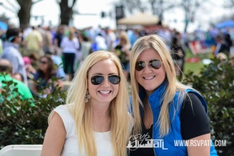
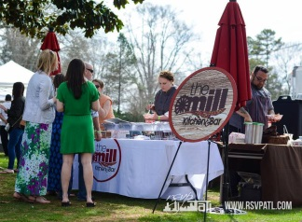
2017 Roswell Beer Festival
‘BREWMASTER’ SPONSOR -$10,000
(Exclusive)
The Brewmaster Sponsor is an exciting opportunity to reach festival attendees and everyone that comes into contact with the event promotion.
Advertising/Public Relations:
Prominent placement of Your company logo on festival press materials, including releases, fact sheets and media alerts, distributed to regional and local media.
Prominent placement of your company logo on all web pages and placement on rotating click-thru banner on the official event web site www.roswellbeerfestival.com
Prominent placement of your company logo in print advertisements, regional and local for entire print ad cycle.
Signage and Collateral:
Your company logo on Banners strategically placed around Roswell 30 days prior to event
Your company logo on back of T-shirts
Your company logo on the tasting glass distributed to all attendees
Your company logo printed on table tents distributed in local restaurants
Your company logo prominently displayed on signage throughout the event site
Your company logo will be displayed on signage hanging across the top of a beer tent!
Hospitality on Site:
Booth space for brand display/distribution at the festival
(16) Complimentary VIP tickets with access to exclusive VIP tasting area
(2) Private Tables in VIP area
Access to VIP restroom facilities
(32) Food tokens

Slide 5
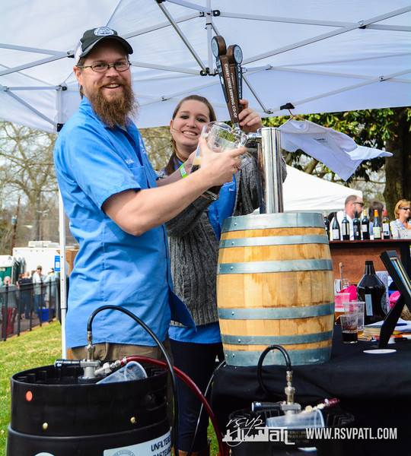
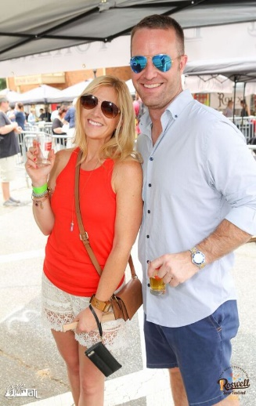
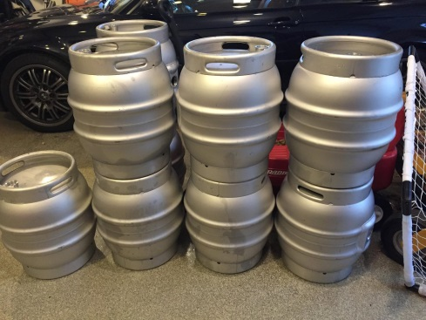
2017 Roswell Beer Festival
KEG SPONSOR -$5,000
Advertising/Public Relations:
Prominent placement of your company logo on all web pages and placement on rotating click-thru banner on the official event web site www.roswellbeerfestival.com
Your company logo acknowledgment on all print advertisement, full ad cycle
Your company logo on all press materials, including releases, fact sheets and media alerts, distributed regionally and locally
Signage & Collateral:
Your company logo on Banners strategically placed around Roswell two weeks prior to event
Your company logo on T-shirts
Your company logo prominently displayed on signage throughout the event site
Your company logo will be displayed on (2) signs hanging across the top of 2 beer tents!
Hospitality & on-site:
(8) Complimentary VIP tickets with access to exclusive VIP tasting area
(1) Private Table in VIP area
Access to VIP restroom facilities
(16) Food tokens

Slide 6
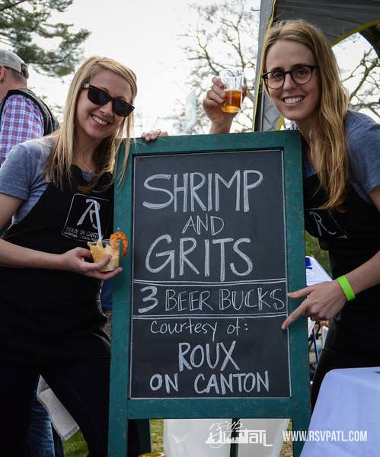
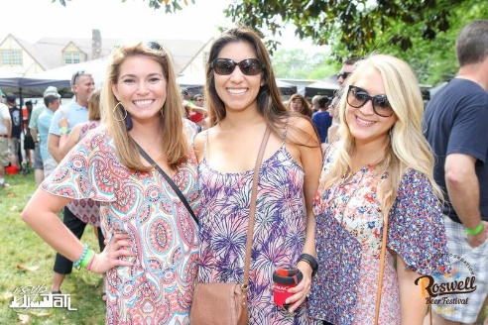
2017 Roswell Beer Festival
FOOD & MERCHANDISE TOKEN SPONSOR -$5,000 (Exclusive)
The Food Token Sponsorship is both exclusive and unique. Festival attendees will be able to purchase food from Roswell’s finest restaurants by using these 1.25” tokens. What better way to promote your brand that having your logo on the front of the coin?
Advertising/Public Relations:
Your company logo on front side of food tokens
Your company logo on all web pages on the official event web site www.roswellbeerfestival.com
Your company logo on all press materials including releases, fact sheets, and media alerts, distributed to regional and local media
Signage & Collateral:.
Your company logo on event banners strategically placed around Roswell 30 days prior to event
Your company logo will be displayed on a sign hanging across the top of a beer tent!
Hospitality on site:
(8) Complimentary VIP tickets with access to exclusive VIP tasting area
Access to VIP restroom facilities
(50) Food tokens

Slide 7
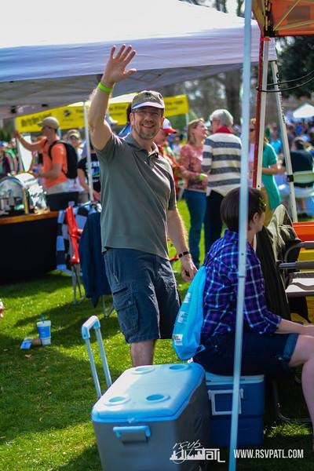
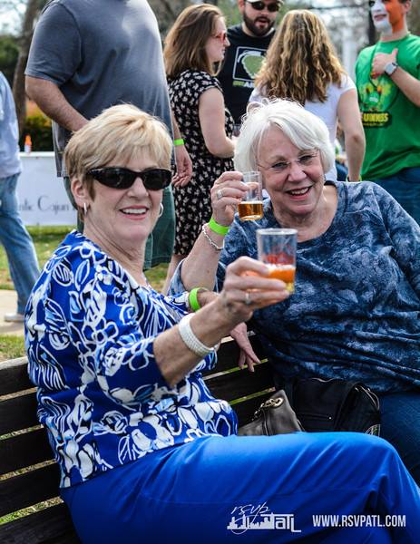
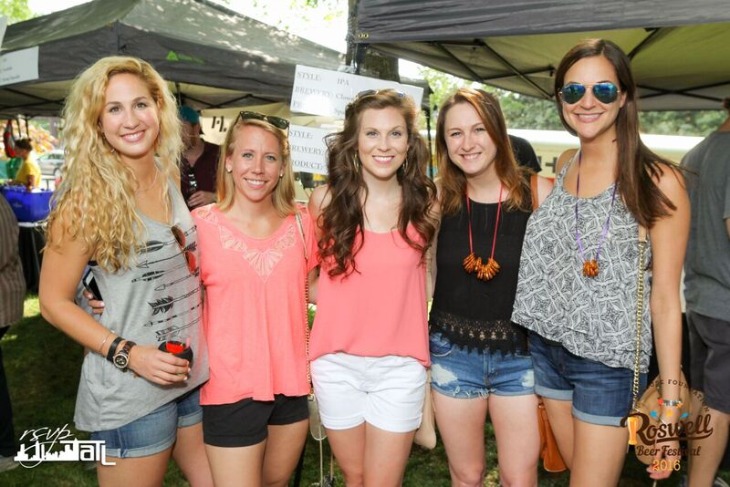
2017 Roswell Beer Festival
TAP SPONSOR- $2,500
Advertising/Public Relations:
Your company logo on web pages on the official event web site www.roswellbeerfestival.com
Your company logo acknowledgment on all print advertisement, full ad cycle
Your company logo on press materials, including releases, fact sheets and media alerts, distributed regionally and locally
Signage & Collateral:
Your company logo on Banners strategically placed around Roswell 30 days prior to event
Your company logo displayed on signage throughout the event site
Your company logo will be displayed on a sign hanging across the top of a beer tent!
Hospitality & on-site:
(4) Complimentary VIP tickets with access to exclusive VIP tasting area
Access to VIP restroom facilities
(8) Food tokens

Slide 8
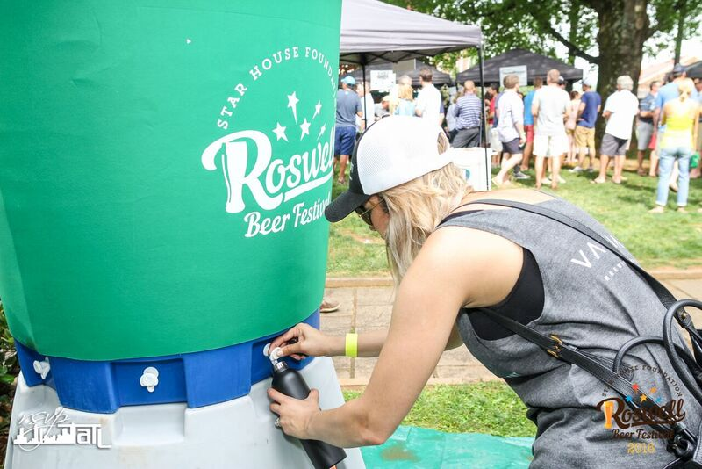
2017 Roswell Beer Festival
WATER SPONSOR -$2,500
(Exclusive)
Advertising/Public Relations:
Sponsor logo at Festival water tower
Sponsor logo placement on rotating click-thru banner on the official web site
Sponsor logo on all press materials including releases, fact sheets, and media alerts, distributed to regional and local media
Signage & Collateral:
Sponsor logo on event banners strategically placed 30 days prior to event
Your company logo will be displayed on a sign hanging across the top of a beer tent!
Hospitality on site:
(4) Complimentary VIP tickets with access to exclusive VIP tasting area
Access to VIP restroom facilities
(8) Food tokens

Slide 9
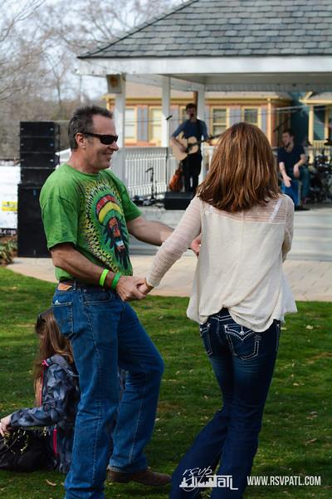
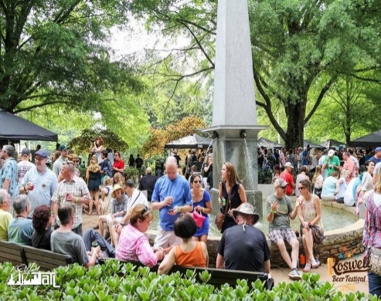
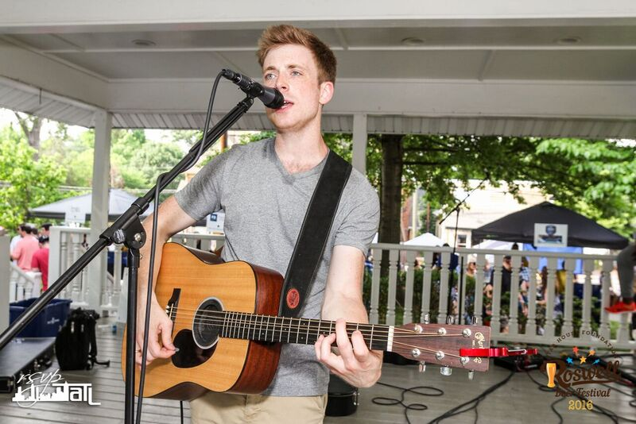
2017 Roswell Beer Festival
MUSIC / ENTERTAINMENT SPONSOR- $2,500 (Exclusive)
Every year the Roswell Beer Festival features up and coming bands who play a variety of music to please all musical tastes. Music sponsorship gives you front-and-center billing at center stage.
Advertising/Public Relations:
Sponsor logo banner on center stage
Sponsor logo placement on rotating click-thru banner on the official web site
Sponsor logo on all press materials including releases, fact sheets, and media alerts, distributed to regional and local media.
Signage & Collateral:
Sponsor logo on event banners strategically placed 30 days prior to event
Your company logo will be displayed on banner over the Gazebo / Center Stage
Your company logo will be displayed on a sign hanging across the top of a beer tent!
Hospitality on site:
(4) Complimentary VIP tickets with access to exclusive VIP tasting area
Access to VIP restroom facilities
(8) Food tokens

Slide 10
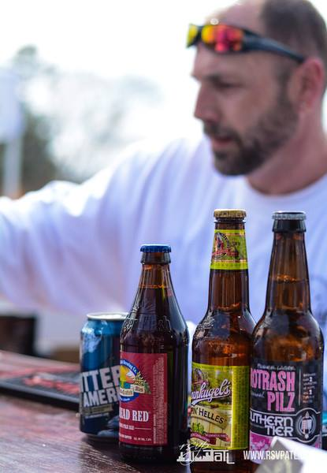
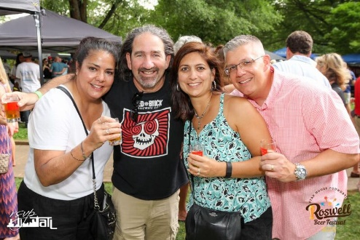
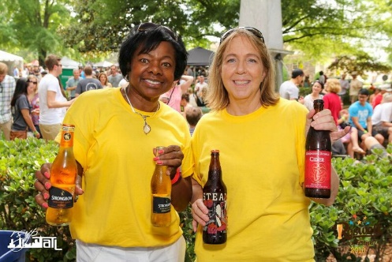
2017 Roswell Beer Festival
PINT SPONSOR - $1,000
Advertising/Public Relations:
Your company logo on all web pages on the official event web site www.roswellbeerfestival.com
Your company logo acknowledgment on all print advertisement, full ad cycle
Your company logo on all press materials, including releases, fact sheets and media alerts, distributed regionally and locally
Signage & Collateral:
Your company logo on Banners strategically placed around Roswell 30 days prior to event
Your company logo will be displayed on a sign hanging across the top of a beer tent!
Hospitality & on-site:
(2) Complimentary VIP tickets with access to exclusive VIP tasting area
Access to VIP restroom facilities
(4) Food tokens

Slide 11
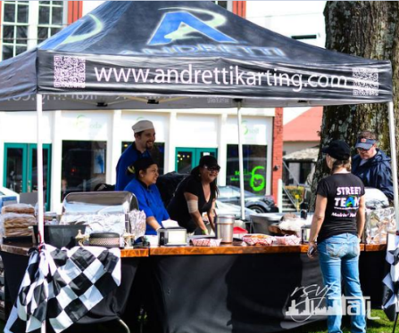
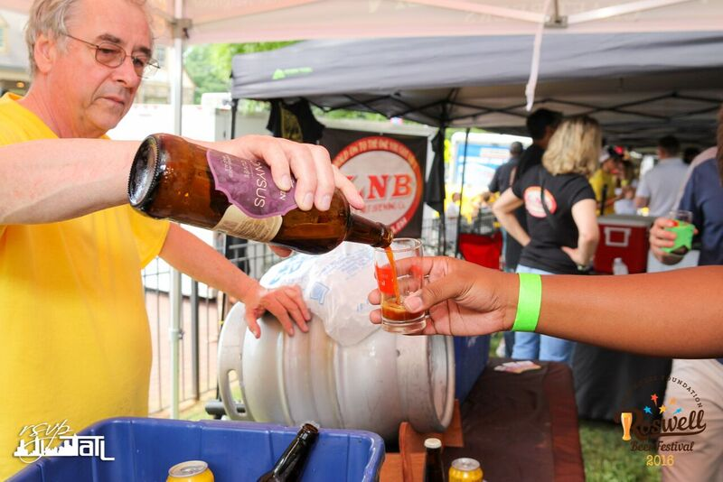
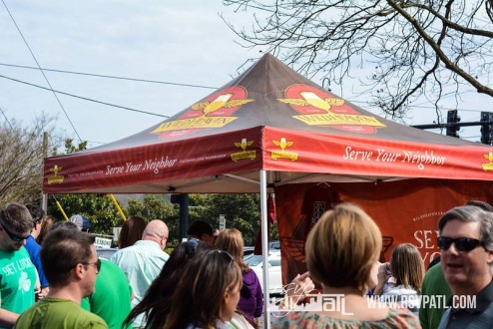
2017 Roswell Beer Festival
BEER TENT SPONSOR - $500
Bring your own branded tent and set up shop with your favorite beers! If you don’t have your own tent, we will supply one. Feel free to come serve beer from your tent and engage with the audience, or we will provide servers for you.
Advertising/Public Relations:
Sponsor logo placement on rotating click-thru banner on the official web site
Sponsor logo on all press materials including releases, fact sheets, and media alerts, distributed to regional and local media.
Signage & Collateral:
Your company logo will be displayed on a sign hanging across the top of a beer tent!
Hospitality on site:
(2) complimentary general admission tickets

